Slide 1
Invasive or Native?
HACKATHON 7 · EYES ON EARTH · SDG 15 LIFE ON LAND
A phone app that tells a field worker whether a plant looks like an invasive species or its harmless look-alike, before they touch it.
Felix Reichle · Ahmet Ünlü
Built with Roboflow · Streamlit
Notes:
Introduce ourselves. One sentence: we built a field ID helper for invasive plants in the Netherlands, trained with Roboflow.

Slide 2

A dangerous plant that looks harmless
THE PROBLEM
1,358
€1.1–3.1 bn
Since 2017
exotic species have established themselves in the Netherlands, 416 of them plants
estimated yearly cost of invasive species to the Netherlands, including indirect costs
giant hogweed is on the EU invasive species list: member states must find and remove it
Giant hogweed sap plus sunlight causes severe burns in people and dogs, yet it looks very much like the harmless native common hogweed.
Sources: Van der Weijden & Reinhold, Landschap 2018 · Provincie Flevoland, factsheet reuzenberenklauw 2022
Notes:
Three invasive plants spread along Dutch verges, parks and waterways: giant hogweed, Japanese knotweed and Himalayan balsam. Each has a harmless native look-alike. Finding them early is far cheaper than removing them later. Giant hogweed is also a health risk: its sap burns skin in sunlight.

Slide 3
Keep my distance and report it, or leave it?
WHO IT IS FOR
Our users
Volunteers, municipal green-space crews and citizen scientists in the Netherlands. Outdoors, with only a phone, often without a field guide.
Why not ObsIdentify or Google Lens?
They give a species name and a confidence, and treat every mistake the same.
Not for
Our app is trained on exactly the pairs that get confused, and prefers a false alarm over a missed giant hogweed: the answer is “do not touch, report it”, not a confident guess.
Removing plants without an expert, plants other than our 7 species, or use outside the Netherlands.
Notes:
The question our user has is not “what species is this?” but “is it safe, and should I report it?”. That is a safety decision, which is why the app is built around unequal mistakes.

Slide 4
840 Dutch photos, 3 invasive plants, 4 look-alikes
THE DATA
Invasive | Native look-alike
Giant hogweed | Common hogweed; cow parsley, wild angelica
Japanese knotweed | Hedge bindweed
Himalayan balsam | Purple loosestrife
Source: research-grade iNaturalist photos from the Netherlands, CC0 / CC BY / CC BY-NC, every photographer credited
Split: 760 for training in Roboflow, 80 kept apart from other sightings and other photographers
Cleaning: max 10 photos per photographer, duplicates removed, 26 rejected by eye
Why species, not “invasive yes/no”? Invasiveness is not visible in a photo. A broad “not invasive” class would teach the model shortcuts like season or background.
Notes:
We trained on species and let the app map species to a verdict. 27 bindweed flower close-ups were swapped for leaf photos so the model would not learn “white flower = bindweed”.

Slide 5

From photo to safety verdict
HOW IT WORKS
1
2
3
4
Photo in
Roboflow model
Safety rules
Verdict
Phone camera or upload, iPhone HEIC works
ViT Base classifier scores all 7 species
Top score below 70% → “Unsure, do not touch”
Invasive, Native or Unsure, how to recognise it, and a button to report on Waarneming.nl
Giant hogweed ≥ 20% → always a warning
Why the rules: the two mistakes are not equally bad. A false alarm costs a report; a missed giant hogweed can cost a burn.
Notes:
Roboflow trains and hosts the model; our Streamlit app calls its API for every photo. The safety rules live in plantid.py and are easy to change.

Slide 6
Two look-alikes, two verdicts
LIVE DEMO
No real plants in class, so we photograph the next two slides with the app:
Giant hogweed → expected Invasive, do not touch
Common hogweed → expected Native
hackathon-7-u97t5prpmjnmzn3wttrzv9.streamlit.app
Notes:
Open the Streamlit link on a phone, tab “Take a photo”. Both photos are from our held-out test set, so the model never saw them. A photo of a screen is harder than a real plant (glare, moiré, colour shift), which is a fair test of messy field photos. Backup if the Wi-Fi fails: screenshots of both results.

Slide 7
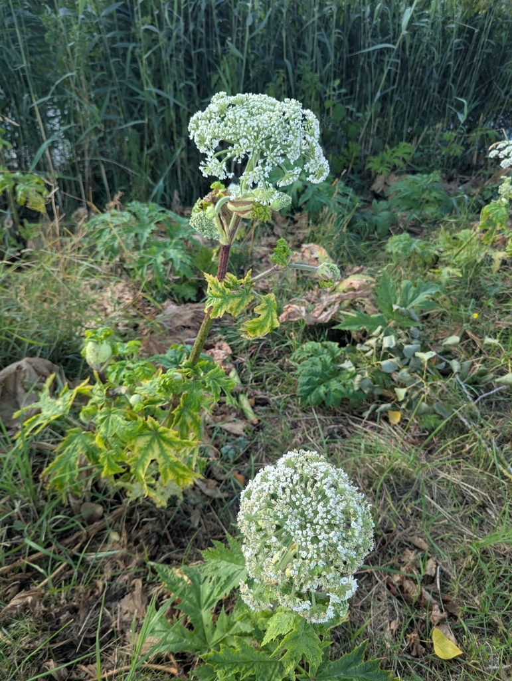
Demo photo 1 · Giant hogweed, Wageningen, 26 June 2025 · © giovanna, CC BY-NC · iNaturalist research grade, held-out test photo
Notes:
Photograph this slide with the app on the phone. Expected: Invasive, do not touch. Point out the purple-spotted stem, the clue that separates it from common hogweed. This photo is from our held-out test set, so the model never saw it in training.

Slide 8
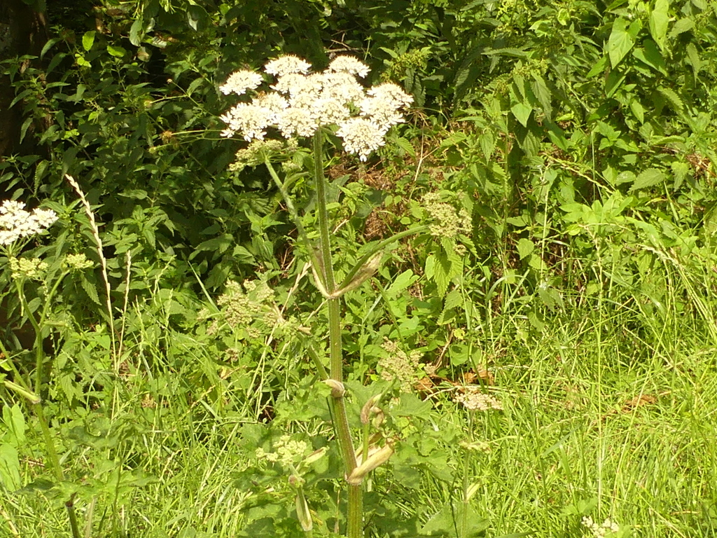
Demo photo 2 · Common hogweed, Alphen aan den Rijn, 9 July 2023 · © Elvira de Lange, CC BY · iNaturalist research grade, held-out test photo
Notes:
Photograph this slide with the app. Expected: Native. If the giant hogweed score is 20% or more, the app warns anyway: that is our safety rule working, not a bug, so explain it if it happens.

Slide 9
Good overall, weakest exactly where it matters
RESULTS
Roboflow test split · 38 photos
Our 80 held-out photos
With the app’s safety rules | Result
Species accuracy | [__%]
Giant hogweed warned about | [__] / 15
Invasive called “Native” (dangerous) | [__] / 35
False alarms on native plants | [__] / 45
82.5%
86.8%
81%
F1
precision
recall
Almost every mistake was hogweed against hogweed: 1 of 4 giant hogweeds was called common hogweed. Roboflow picks this split at random, so scores may look better than they are.
Other sightings and other photographers than the training photos: the stricter test.
Notes:
The held-out test runs evaluate.py, which sends every photo through the model exactly like the app does, safety rules included. The number to focus on: how often a giant hogweed was called Native.

Slide 10
Where it can fail, and who pays for it
DATA CARD · ETHICAL REFLECTION
Gaps in the data
What could go wrong
What we did
Mostly sharp summer photos in flower. Autumn and winter: only 19% for giant hogweed, 3% for bindweed, 9% for loosestrife.
Giant hogweed called “Native”: someone touches it and gets burned.
70% “unsure” rule and 20% giant hogweed warning
Any other plant is forced into one of the 7, e.g. poisonous hemlock.
A strict held-out test set
Photos cluster around popular places; labels come from community votes.
Every invasive or unsure result goes to Waarneming.nl, where an expert confirms it
Over-trust: cutting knotweed spreads it.
Notes:
Our data card is our ethical reflection. Biggest honest limitation: the seasons. A volunteer in October photographs dead stems, which our data barely contains, and the model may partly have learned “dead stems = invasive”. Next step: more winter photos and an “other plant” class.

Slide 11
The model was the easy part
WHAT WE LEARNED
Choose the right labels
Mistakes are not equal
Train on species, then map to invasive or native. “Invasive” is not something a camera can see.
A missed giant hogweed is worse than a false alarm, so the app gets safety rules, not just a top answer.
Online data has a season
Augment with care
Scraped photos are sunny summer shots. Real users also photograph dead stems in October.
No grayscale or 90° rotation: colour and orientation are real clues for these plants.
Notes:
Close with the one lesson we would defend hardest: designing for unequal mistakes. Then questions.

